Slide 1
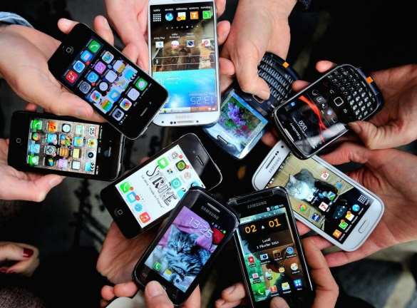
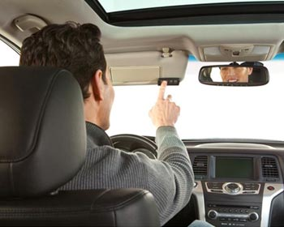
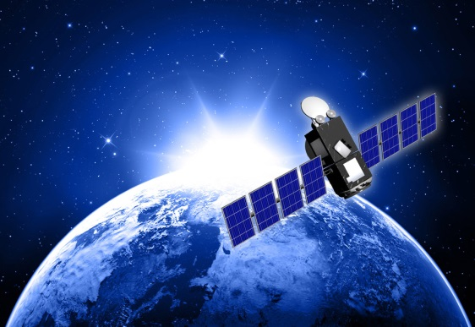
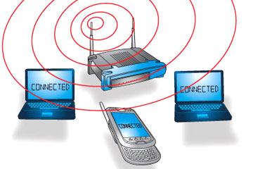
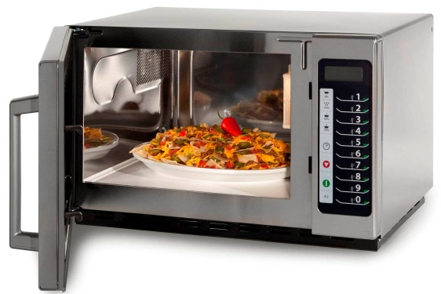
What is Radio? [Req 1]
1-1
1-2
1-3
1-4
1-5
1-6
Notes:
2 minutes for this slide Start 00:00
Ask: How many of you use radio every day?
[Ask how; challenge anyone who says “no”]
Today we get our entertainment, news and other information over the Internet
[CLICK 1-1] The Internet usually makes it to our devices through radio using WiFi
[CLICK 1-2] In addition to WiFi, we get information via satellite, another radio method that is very strong.
But radio isn’t just entertainment and information.
[CLICK 1-3] We use radio when we operate our mobile phones.
[CLICK 1-4] We use radio when we open the garage door remotely.
[CLICK 1-5] We use radio when we heat something in the microwave oven.
[CLICK 1-6] We even use radio when the EZPass in our car communicates with the gate to charge us the toll and let us through.
SLIDE END 02:00

Slide 2
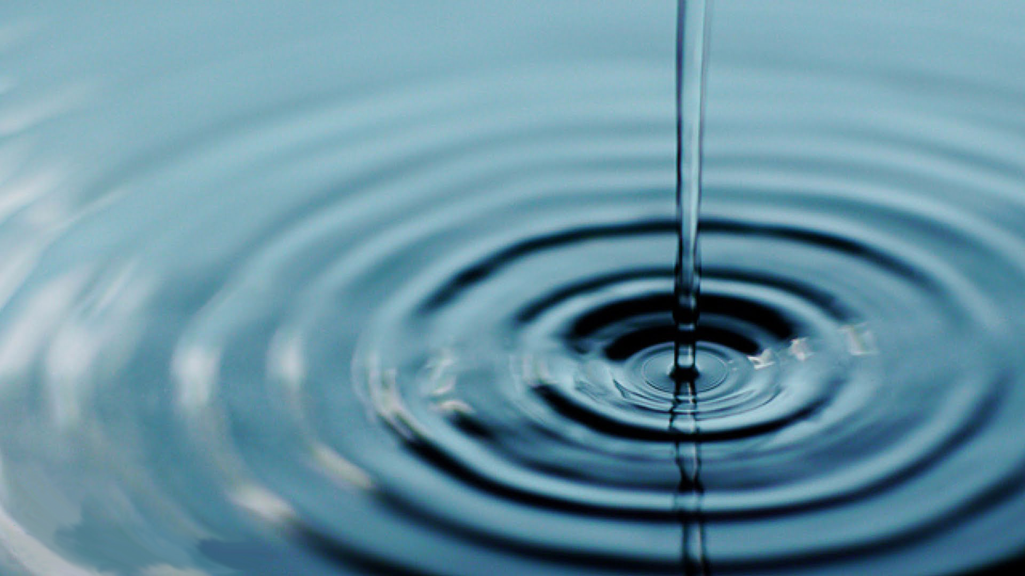
What is Radio? [Req 1]
ANTENNA
2-1
2-2
2-3
Notes:
2 minutes for this slide Start 02:00
Radio is about a lot of things, “radio waves” being an extremely important part. There are all sorts of radio waves.
[CLICK 2-1] We often compare radio waves with the ripples in water caused by a thrown rock.
[CLICK 2-2] Instead of throwing a rock, radio waves are somehow thrown by some sort of antenna.
[CLICK 2-3] Waves of many different types will start at the antenna and travel in many directions for long distances, sometimes around the world.
We’re pretty sure they don’t look like the waves shown here, but at least you get the idea.
And these waves are all around us, right here where we’re at. The ones coming from our K2BSA antennas are much stronger up high at the
SLIDE END 04:00

Slide 3
What is Radio? [Req 1]
Receiving
Antenna
Transmitting
Antenna
KWM-2
Voice
Into
Microphone
Radio
Transmitter
Radio
Receiver
Loud
Speaker
3-1
3-2
3-3
3-4
3-5
3-6
3-7
3-8
Notes:
5 minutes for this slide Start 04:00
Radio is wireless; the Internet is NOT wireless; cable TV is NOT wireless;
Radio is “OFF THE GRID.” That’s what makes radio cool! If electrical power, cell phone and telephone service goes out, you can still get through with radio! (using batteries, generators, solar, etc.)
[CLICK 3-1] Radio uses transmitters to generate energy waves and a radio receivers to detect them and make them useful
There can be tens, hundreds or thousands of miles between a transmitter and receiver, across the city, county, country or WORLD (or SPACE!)
[CLICK 3-2] Transmitters must be connected to an antenna to send out the waves
[CLICK 3-3] Receivers must also have some sort of antenna to collect the waves
[CLICK 3-4] These energy waves are generated when some sort of signal (like a voice into a microphone) is presented to a radio transmitter
[CLICK 3-5] The transmitter converts the voice (in this example) to radio wave energy and sends this energy up to the antenna
[CLICK 3-6] The antenna throws-off the waves in directions and distances based on how the system is designed
[CLICK 3-7] The transmitted energy waves are collected by any receiving antenna designed to detect them, and sends the radio wave energy down to the receiver.
[CLICK 3-8] The radio receiver processes the energy waves and converts them into audio that you can hear either through a speaker or headphones
Many radio receivers can be directly connected to a computer where the signal is digitized.
SLIDE END 09:00

Slide 4
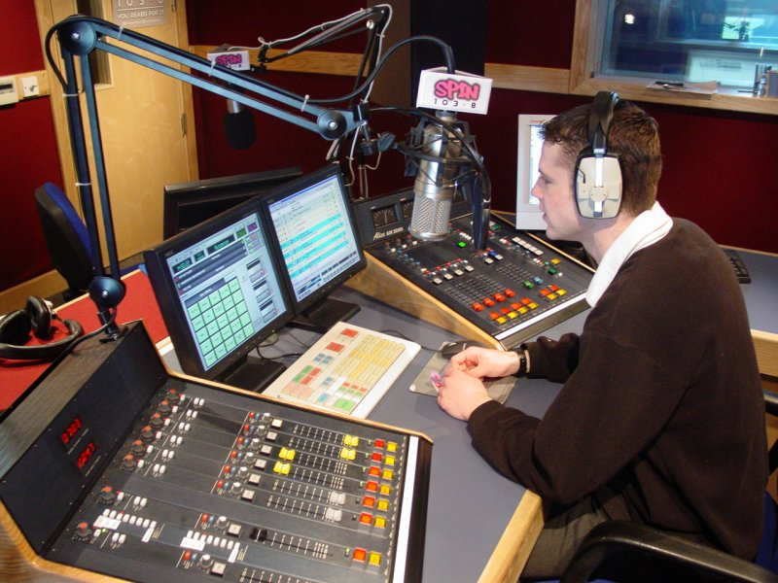
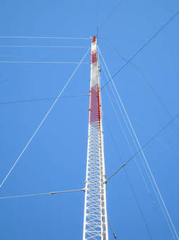
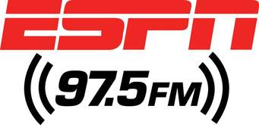
Broadcast Radio vs. Hobby Radio [Req 1a]
4-1
Notes:
One minute for this slide Start 09:00
Broadcast radio used to be a major entertainment source before the Internet. Today there are still many good music radio stations, but there are a huge number of talk radio stations such as ESPN.
Usually, a broadcast radio station has one or more studios like this one, with large “boards” (the equipment with all the buttons and knobs) and of course, computers.
[CLICK 4-1] Broadcast stations also use large antenna towers like this one, to make sure their signal can reach as many of their intended audience as possible. When there is a hill or small mountain nearby a populated area, you’ll see one or more of these!
SLIDE END 10:00

Slide 5
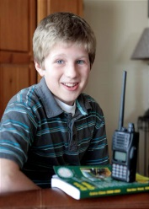
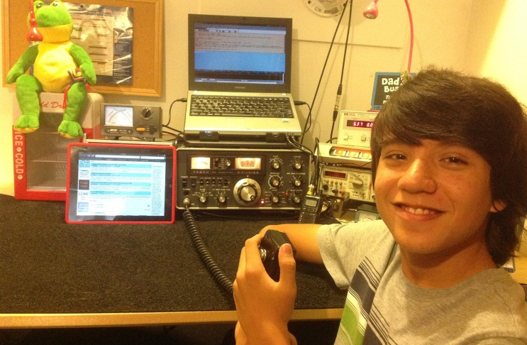
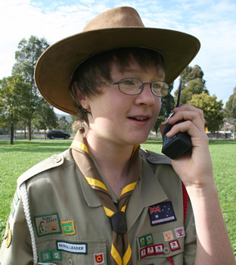
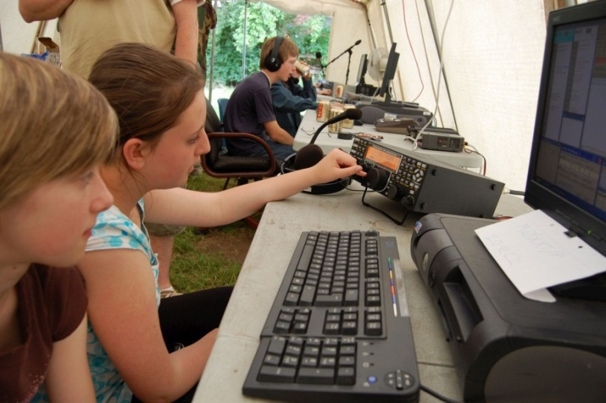
Broadcast Radio vs. Hobby Radio [Req 1a]
5-1
Notes:
2 minutes for this slide 10:00
[CLICK 5-1] Radio as a hobby is very popular.
Probably the single biggest group of hobby radio people is with ham radio operators
There is no minimum age; every one of you in this class could get an amateur radio license.
Another type of hobby radio is Radio Control of cars, boats and airplanes.
Citizens Band radio is used by many truckers.
Even people like to play around with Family Radio Service (FRS) radios when they’re out and about.
SLIDE END 12:00

Slide 6
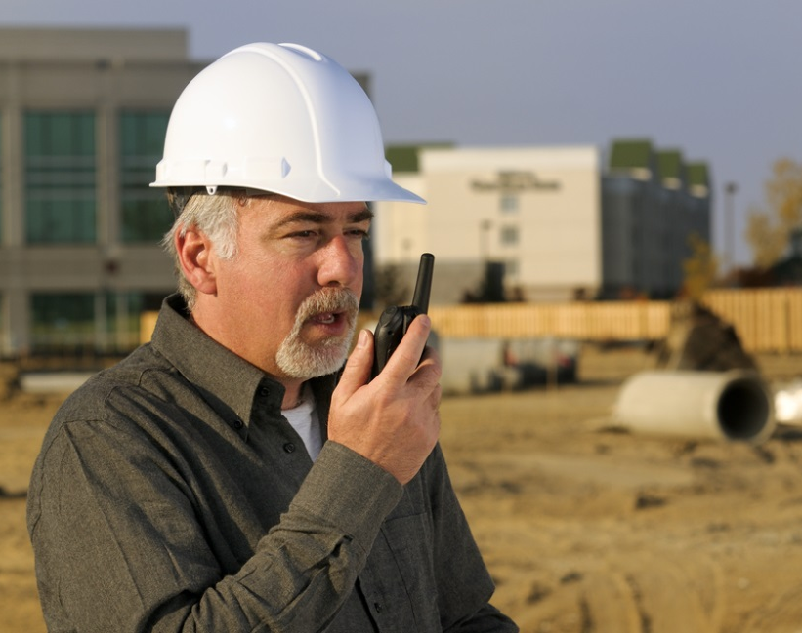
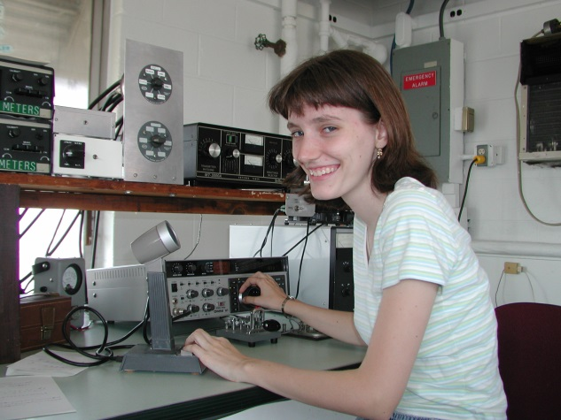
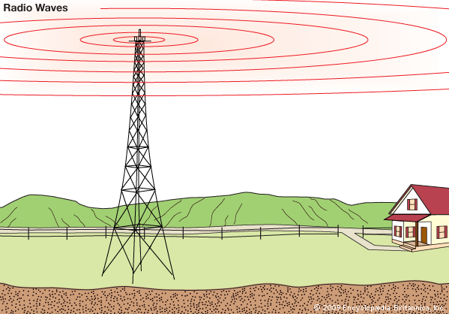
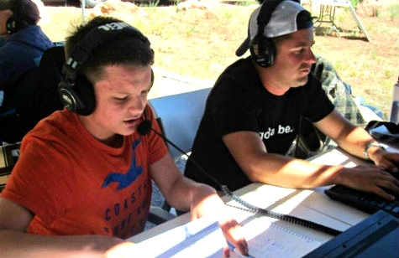
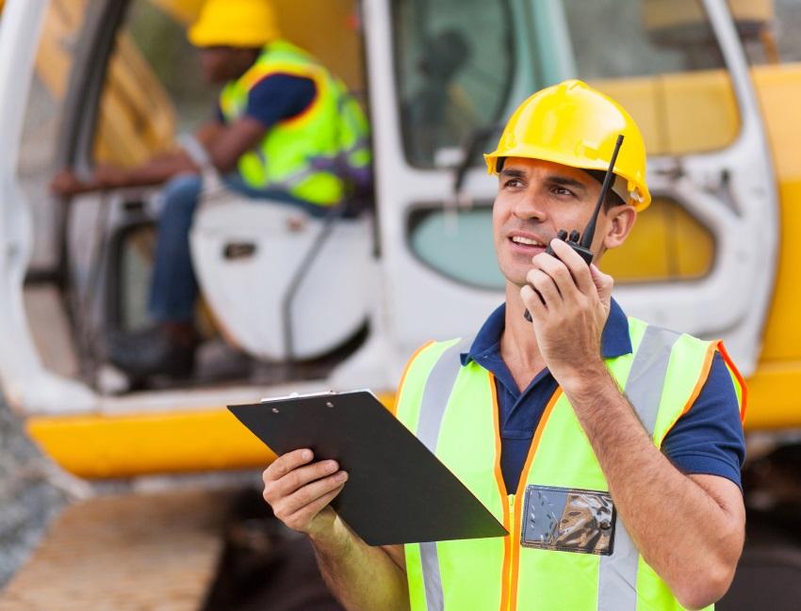
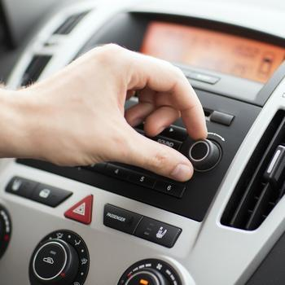
Broadcasting vs Two Way Communication [Req 1b]
6-1
6-2
6-3
Notes:
1 minute for this slide Start 13:00
Broadcasting is one-way communication.
[CLICK 6-1] Usually you can spot a broadcasting antenna; it’s very tall and such antennas are usually located near large population areas.
Everyone can listen-in on their radio to the programming.
Broadcasting is usually operated as a business, where advertisers pay to have their products/services advertised over the air waves.
Two-Way Communication is just that; it’s NOT one-way broadcasting; there are always two (or more) involved
[CLICK 6-2] Businesses use two-way communication to be more efficient.
[CLICK 6-3] Ham radio operators use two-way communication in emergencies, when experimenting with equipment and antennas, and mostly for fun!
SLIDE END 14:00

Slide 7
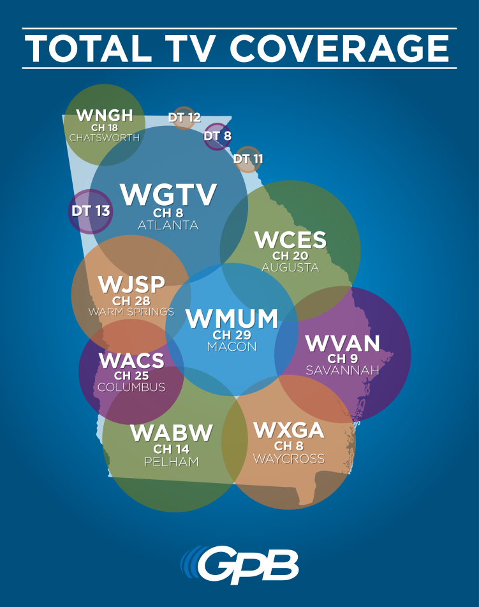
Radio Station Call Signs [Req 1c]
7-1
7-2
Notes:
2 minutes for this slide Start 14:00
Call signs are a unique identification for a licensed radio station.
[CLICK 7-1] Broadcast radio station call signs are three or four letters such as the FM station above and the television broadcasting stations on the right.
Cable television does not use call signs because their signal does not travel over the airwaves
[CLICK 7-2] U.S. Amateur radio station call signs are letters and a number such as the one shown above
SLIDE END 16:00

Slide 8
Radio Station Call Signs [Req 1c]
K2GW
K2GW
K2GW
AA - AL
K
KA - KZ
N
NA - NZ
W
WA - WZ
AD4UM
0 - 9
AD4UM
AD4UM
N7QR
N7QR
N7QR
WB8AXP
WB8AXP
WB8AXP
8-1
8-2
8-3
Notes:
2 minutes for this slide Start 16:00
[CLICK 8-1] Every licensed ham radio operator is assigned a unique call sign.
[CLICK 8-2] All U.S. ham radio operators have call signs beginning with AA-AL, K, N or W
[CLICK 8-3] Each U.S. ham radio operator also has a single number in their call letters, 0-9
SLIDE END 18:00

Slide 9
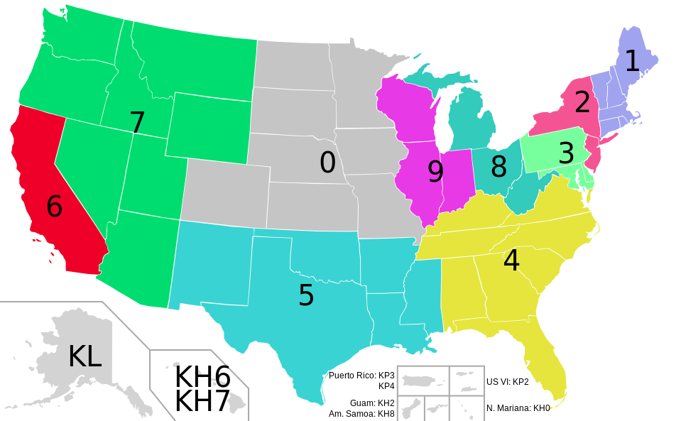
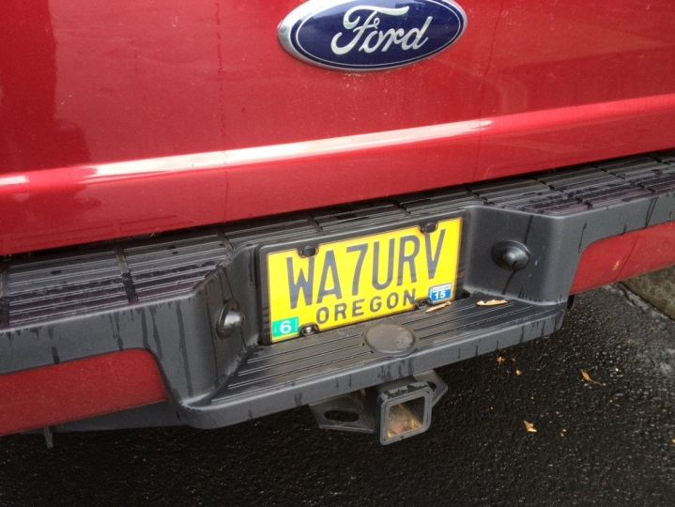
Radio Station Call Signs [Req 1c]
Adding
International Call Signs
9-1
9-2
Notes:
2 minutes for this slide Start 18:00
The number in our call shows the call sign district where our first license was granted.
(If you move to another district, you keep the same number. You can’t be sure anymore that a person with a certain district number actually lives in that district…)
If each one of you passed the requirements for your ham radio license where you lived right now, what would the number be in your call?
[CLICK 9-1] It is very common for ham radio operators to have a custom license plate made for their vehicle, like this one.
<Create Your Imaginary Call Sign>
Pick K, N, or W, a number, and add your initials
SLIDE END 20:00

Slide 10
Phonetic Alphabet [Req 1d]
A
lfa
H
otel
O
scar
V
ictor
B
ravo
I
P
W
ndia
apa
hiskey
C
harlie
J
Q
X
uliet
uebec
-ray
D
elta
K
ilo
R
omeo
Y
ankee
E
cho
L
ima
S
ierra
Z
ulu
F
oxtrot
M
T
ike
ango
G
olf
N
ovember
U
niform
10-1
Notes:
3 minutes for this slide Start 20:00
Many letters sound similar over the radio.
Weak radio signals and noise might make it difficult to hear voices.
The letters B, C, D, E, G, P, T, V or Z might sound the same.
For instance, a guy who gives his name “Phil” during a radio transmission is often mistaken for the name “Bill”
An operator for whom English is not a native language may pronounce letters differently, too.
[CLICK 10-1] Radio operators use a standardized phonetic alphabet to improve understanding and avoid communication errors.
Now each of you speak the call you made a couple minutes ago, using the phonetic alphabet words instead of just saying the letters.
<Instructor give his own example>
SLIDE END 23:00

Slide 11
What is Radio? [Req 1]
S
A
B
11-1
11-2
11-3
11-4
11-5
11-6
Notes:
2 minutes for this slide Start: 23:00
Ask: Have you ever looked closely at the Radio Merit Badge itself?
There are strange little markings around the top of the merit badge, above the “lightning bolts”
[CLICK 11-1] The first little group is a dash followed by three dots.
[CLICK 11-2] In Morse Code, that’s the letter “B”
[CLICK 11-3] The second group is three dots
[CLICK 11-4] The letter “S”
[CLICK 11-5] Can you guess what the third is?
[CLICK 11-6] A dot and a dash for the letter “A”
“BSA”
Morse Code was the first kind of message sent by man using radio waves.
REQUIREMENT 1 END 25:00
THIS SLIDE OPTIONAL AS TIME ALLOWS

